Slide 1

KIDTELLECTUAL
Project Presentation
By
Enrollment Number Student Name
Guided By
Sonali Patil
MITU21BTCS0702 VEDANT MHASKE
MITU21BTCS0641 SURAJ KOLPE
MITU21BTCS ANKIT BHARDWAJ
Department of Computer Science & Engineering, MITSoC, Loni Kalbhor

Slide 2
Outline
1 INTRODUCTION
2 CONCEPTS AND METHODS
3 LITERATURE SURVEY
4 PROJECT PLAN
5. SOFTWARE REQUIREMENT SPECIFICATION
6 RESULTS
7 SOFTWARE TESTING
8 CONCLUSION AND FUTURE WORK
BIBLIOGRAPHY
ANNEXURE A: List of Publications and Research Paper (In its Original formats)
ANNEXURE B: Plagiarism Report
Department of Computer Science & Engineering, MITSoE, Loni Kalbhor

Slide 3
1. Introduction
In the rapidly evolving digital age, children face significant challenges and risks as they navigate the online world. These challenges stem from a lack of awareness, skills, and preparedness in practicing digital citizenship and ensuring online safety. Many children lack the knowledge to engage responsibly, share thoughtfully, and protect their personal information while online. This knowledge gap can lead to experiences of confusion, fear, and vulnerability among young users. To address these pressing issues, the Kidtellectual project aims to empower children aged 4-12 with comprehensive education in digital citizenship and online safety. By offering an interactive and engaging learning experience, the project seeks to equip children with the necessary tools and skills to confidently explore the digital landscape while minimizing risks and challenges.
Department of Computer Science & Engineering, MITSoE, Loni Kalbhor

Slide 4
2. Problem Statement
In today's digital age, children face several challenges and problems while navigating the online world.
These issues arise due to a lack of awareness, skills, and preparedness in practicing digital citizenship and ensuring online safety.
Department of Computer Science & Engineering, MITSoE, Loni Kalbhor

Slide 5
3. Objectives
Our goal is to empower children to explore the online world with confidence while ensuring their safety.
Children should learn to share responsibly and communicate thoughtfully online, keeping personal information private.
Videos
Image – Based
Self Learning
Classroom learning
Activity learnings
Slides and teaching
Reward System
Parental safety measures
Explore social media through our app.
Department of Computer Science & Engineering, MITSoE, Loni Kalbhor

Slide 6
4. Concepts and Methods
Concept:
Promoting Digital Citizenship and Online Safety for Children
Method:
1. Educational Initiatives
2. Parental Involvement
3. Online Safety Tools and Resources
4. Peer Support and Mentoring
5. Community Involvement
6. Promote Critical Thinking
7. Online Etiquette and Respect
8. Regular Communication
9. Evaluating and Updating Policies and Feedbacks
Department of Computer Science & Engineering, MITSoE, Loni Kalbhor

Slide 7
5. Literature Survey
In today's digital age, children encounter a multitude of challenges and problems while navigating the online world. These issues often stem from a lack of awareness, skills, and preparedness in practicing digital citizenship and ensuring online safety. From cyberbullying and privacy concerns to digital literacy and parental involvement, this presentation will delve into the complex landscape of children's online experiences. We will explore key themes and findings from relevant research to better understand the issues at hand and discuss strategies for promoting a safer and more responsible online environment for our younger generation.
Department of Computer Science & Engineering, MITSoE, Loni Kalbhor

Slide 8
6. Tools and Languages
Tools:-
Figma(For designing of app)
Remixicon.com ( tags required for app )
Backend( Airtable.com )
Database connectivity for frontend (Bravostudio.com)
Department of Computer Science & Engineering, MITSoE, Loni Kalbhor

Slide 9
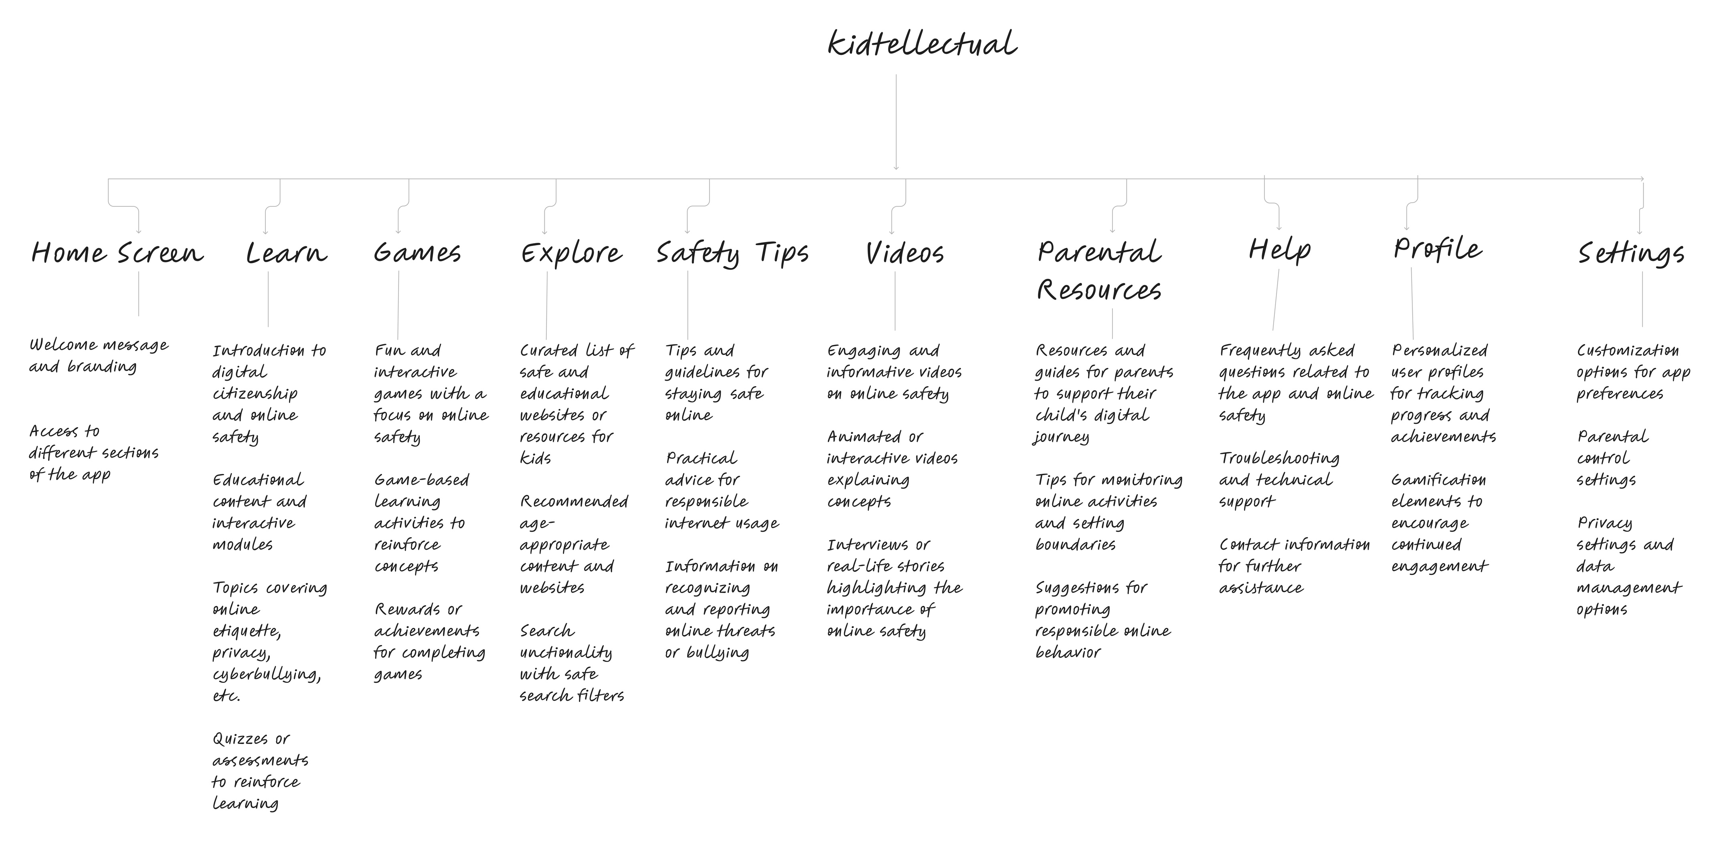
7. Process and Architecture
Department of Computer Science & Engineering, MITSoE, Loni Kalbhor

Slide 10
8. Implementation
Department of Computer Science & Engineering, MITSoE, Loni Kalbhor

Slide 11
9. Results
Department of Computer Science & Engineering, MITSoE, Loni Kalbhor

Slide 12
10. Conclusion and Future Work
In end, Kidtellectual performs a critical function in equipping children with the essential understanding and talents to navigate the virtual international responsibly and securely. By instructing them on the fundamentals of digital citizenship and on line safety, Kidtellectual serves as a parent, fostering a secure and enriching on line experience for youngsters. Through its engaging and informative method, the platform empowers children to make knowledgeable alternatives and broaden a feel of virtual resilience, ensuring their holistic improvement inside the virtual age.
Looking in advance, the future of Kidtellectual holds large capability for enlargement and innovation. By incorporating interactive modules and gamified gaining knowledge of reports, the platform can beautify engagement and make the learning technique more enjoyable for kids. Additionally, the combination of superior technologies along with artificial intelligence and system getting to know may want to in addition customise the getting to know journey, catering to every child's precise needs and choices.
Department of Computer Science & Engineering, MITSoE, Loni Kalbhor

Slide 13
11. List of Publications
The Impact of Educational Apps on Student Learning: A Comprehensive Review (Author:-Hung, J., & Hwang, G. J.) Journal of Educational Technology & Society (2021)
The Best Educational Apps for Kids of All Ages (Author: Wired Staff) Wired (2023)
The Future of Educational Apps (Author:- Ingrid Lunden) TechCrunch (2023)
Babbel: A Case Study of a Paid Educational App (Author:- Ingrid Lunden)TechCrunch (2023)
Kahoot!: A Case Study of a Gamified Educational App (Author:- Morten Lindvall & Einar Sunde)The Journal of Educational Technology & Society (2018)
Lumosity: A Case Study of a Brain Training Educational App (Author:-Adam Gazzaley, Michael Klingberg, Tobias Thorell, and Susanne Bergman Nutley) Nature Neuroscience (2014)
Department of Computer Science & Engineering, MITSoE, Loni Kalbhor

Slide 14
References
[1] F. Jia and L. Z. Kong, “Intrusion Detection Algorithm Based on Convolutional Neural Network,” "Beijing Ligong Daxue Xuebao/Transaction Beijing Inst. Technol., vol. 37, no. 12, pp. 1271–1275, 2017, doi: 10.15918/j.tbit1001-0645.2017".12.011.
[2] L. Mohammadpour, T. C. Ling, C. S. Liew, and C. Y. Chong, “A Convolutional Neural Network for Network Intrusion Detection System,” "Proc. Asia-Pacific Adv. Netw., vol. 46, no. 0, pp. 50–55", 2018.
[3] U. Gur Çekmez et al., “Derin Ö˘ grenme ile A˘ g Anomali Tespiti Network Anomaly Detection with Deep Learning Ozgur Koray Sahingoz,” 2018, pp. 1–4.
[4] A. Chawla, B. Lee, S. Fallon, and P. Jacob, “Host Based Intrusion Detection System with Combined CNN/RNN Model,” "Lect. Notes Comput. Sci. (including Subser. Lect. Notes Artif. Intell. Lect. Notes Bioinformatics), vol. 11329 LNAI", pp. 149–158, 2019.
[5] S. Naseer and Y. Saleem, “Enhanced network intrusion detection using deep convolutional neural networks,” "KSII Trans. Internet Inf. Syst., vol. 12, no. 10, pp. 5159–5178, 2018, doi: 10.3837/tiis.2018".10.028.
Department of Computer Science & Engineering, MITSoE, Loni Kalbhor

Slide 15
Thank You
Department of Computer Science & Engineering, MITSoE, Loni Kalbhor

Slide 16
Questions
Department of Computer Science & Engineering, MITSoE, Loni Kalbhor

